Slide 1

Team Name: NiteWare
Nov 30th – Dec 2nd 2018 | National Incubation Center, Karachi
Challenge Theme: PUBLIC SAFETY
LACK OF EFFECTIVE SURVEILLANCE AND MONITORING SYSTEM
Team Participant Names:
1. Azeem Baloch
2. Muhammad Shariq
3. Muhammad Sameer Aamir
What technologies does your solution leverage?:
Web
Android

Slide 2

Civic Tech Hackathon 2018 | Problem-Solution Fit
What is your well-defined solution?
One App, one account and a single online hub to find and secure your smart phone.
How does your solution mitigate the challenge theme issue?
Death Toll: 1000 people lose their lives over every 90000 phones.
The fear of loosing valuable data and smartphone is what makes the situation turn into disaster with no worries of data or recovery of phone precious lives can be saved.

Slide 3
Civic Tech Hackathon 2018 | Potential Impact
Does your application solve a widespread community problem?
90 lacs smartphone users peoples in Karachi alone to be exact.
Is there any market research on the problem and solution?
There are traces of research on the problem, but there is no effective solution to it.
Can the solution be scaled easily to actual deployment in the real world?
We primarily are focused on the smart phones, it can be largely scaled on to other devices such as Laptops, tablets.

Slide 4
Civic Tech Hackathon 2018 | Novelty & Learning
What is different/novel about your solution?
The traditional apps to secure the phone fail after the smartphone is restored to factory settings (restored to default setting).
Has your solution been done before?
Yes there are other solutions on the surface before like CPLC (Blocking phone).
What about your solutions hasn’t been done before?
The application integration into the system is the part where magic happens.

Slide 5
Civic Tech Hackathon 2018 | Prototype
How easy to use is your application?
A single sign-up with email is all the application demands.
Is the user experience elegant and engaging?
We have worked on making things easy for user where all the things are done on a single tap.
Is your prototype demo functional and well-implemented?
The synchronization of app with the web-portal is functional.
A fail-proof system.

Slide 6
Civic Tech Hackathon 2018 | Sustainability
Is your team committed to scaling/deploying your application beyond this hackathon?
More than committed and focused.
Will your app be adopted by users (govt/citizens/media) & its usage bee sustained over time?
The app is modeled to be a standard that can be adopted not only government but also by phone developing industries which ensures the safety of devices of their users thus increasing their product value.

Slide 7
Do you have a business model?
The product can generate ROI using the principle of network economics. There are subscription plans which fulfills different customers need.
Basic – Free Package
Track 3 devices
Track your lost devices
Recover the lost devices
3 control zones
Notification through email
Buzz your phone
Budget Package
Track 5 devices
Track your lost devices
Recover the lost devices
5 control zones
Notification through email and cellular messaging
Block phone
Buzz phone
Custom Package
Track as many devices per choice
Track your lost devices
Recover lost devices
Unlimited control zones
Notification through email and cellular messaging
Block phone
Data protection features
Buzz phone

Slide 8
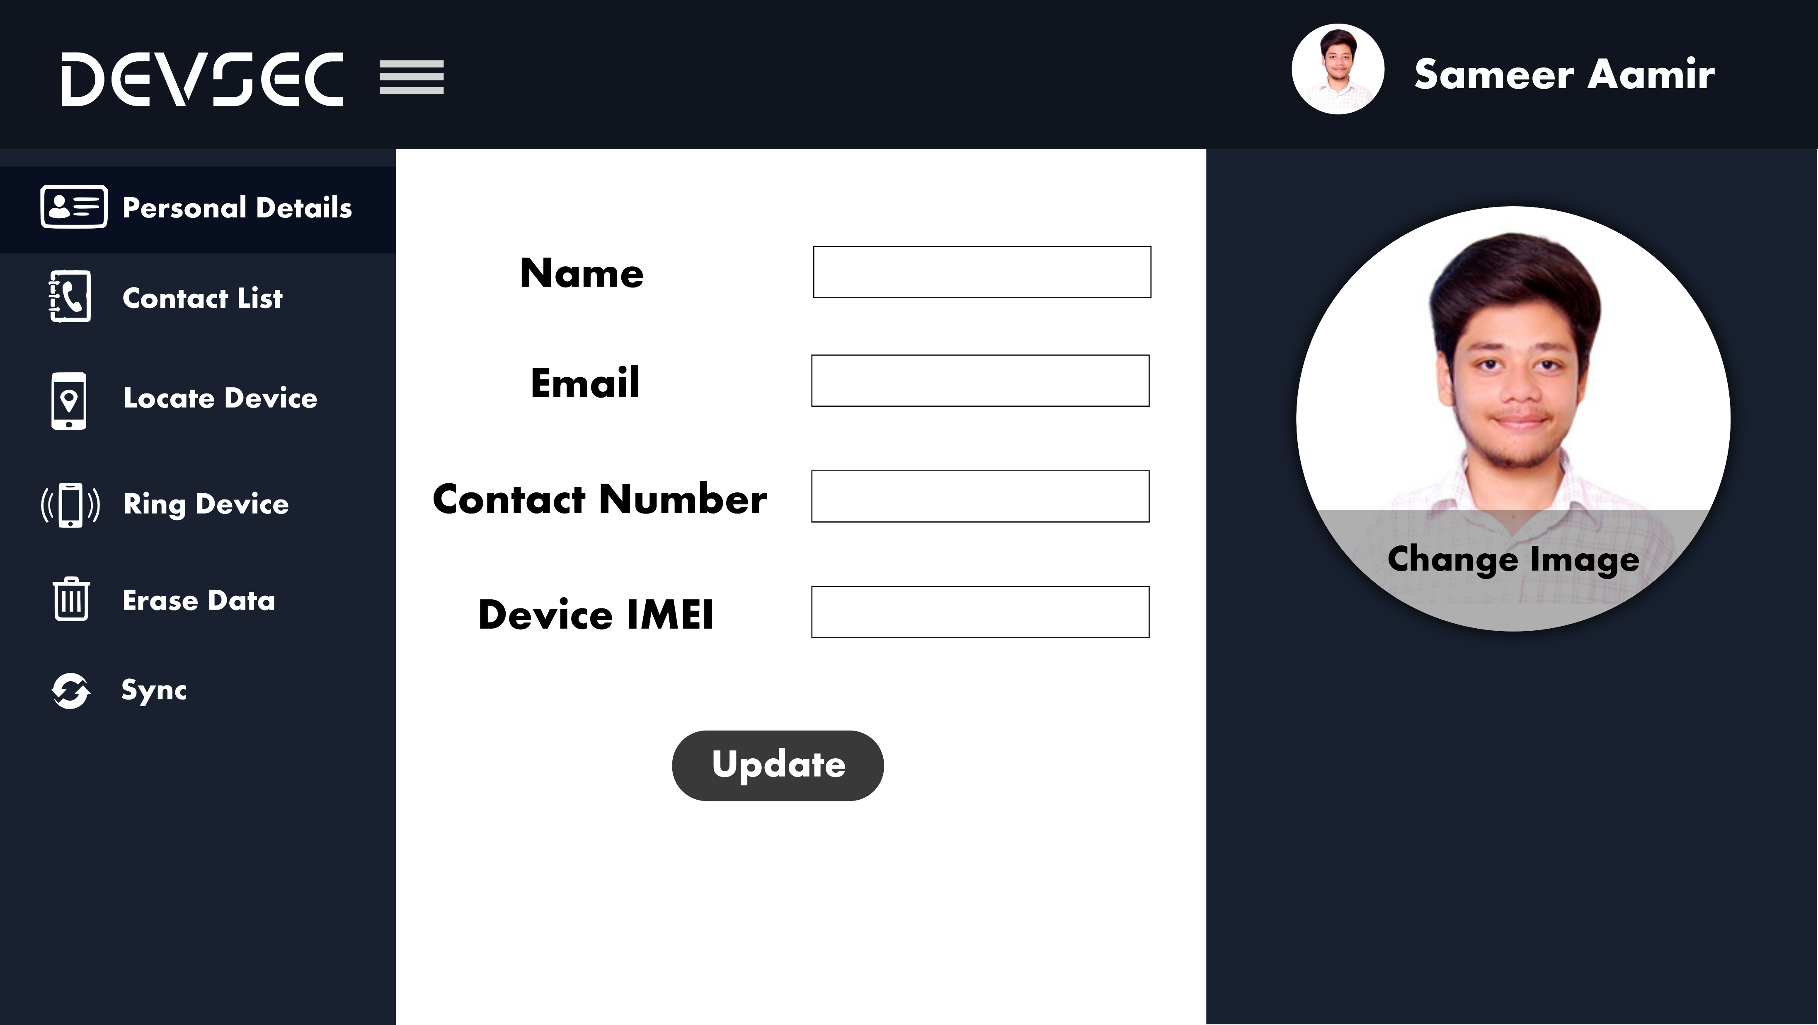

Slide 9
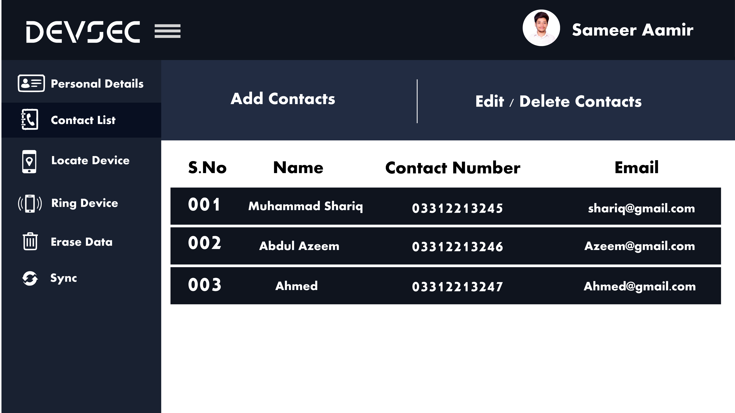

Slide 10
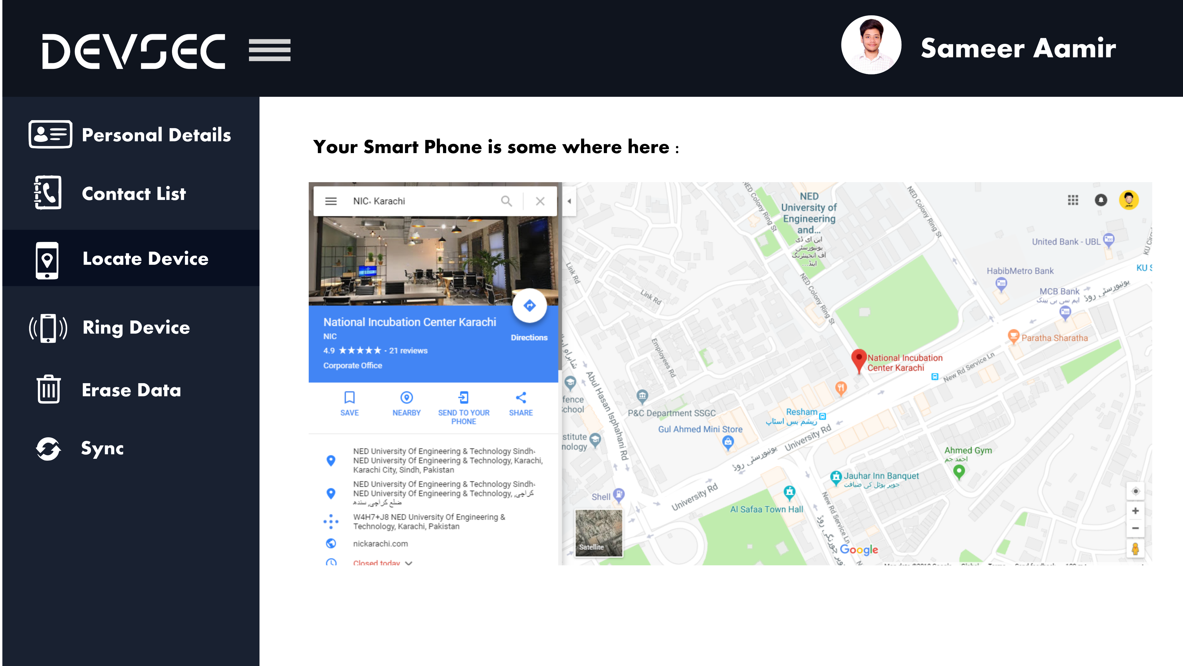

Slide 11
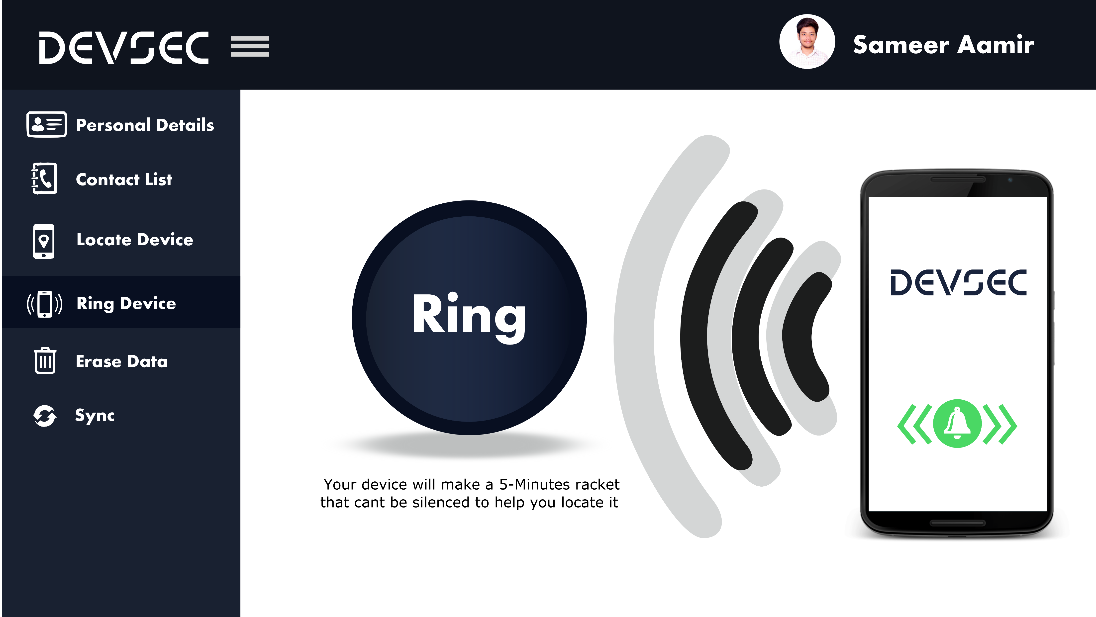

Slide 12
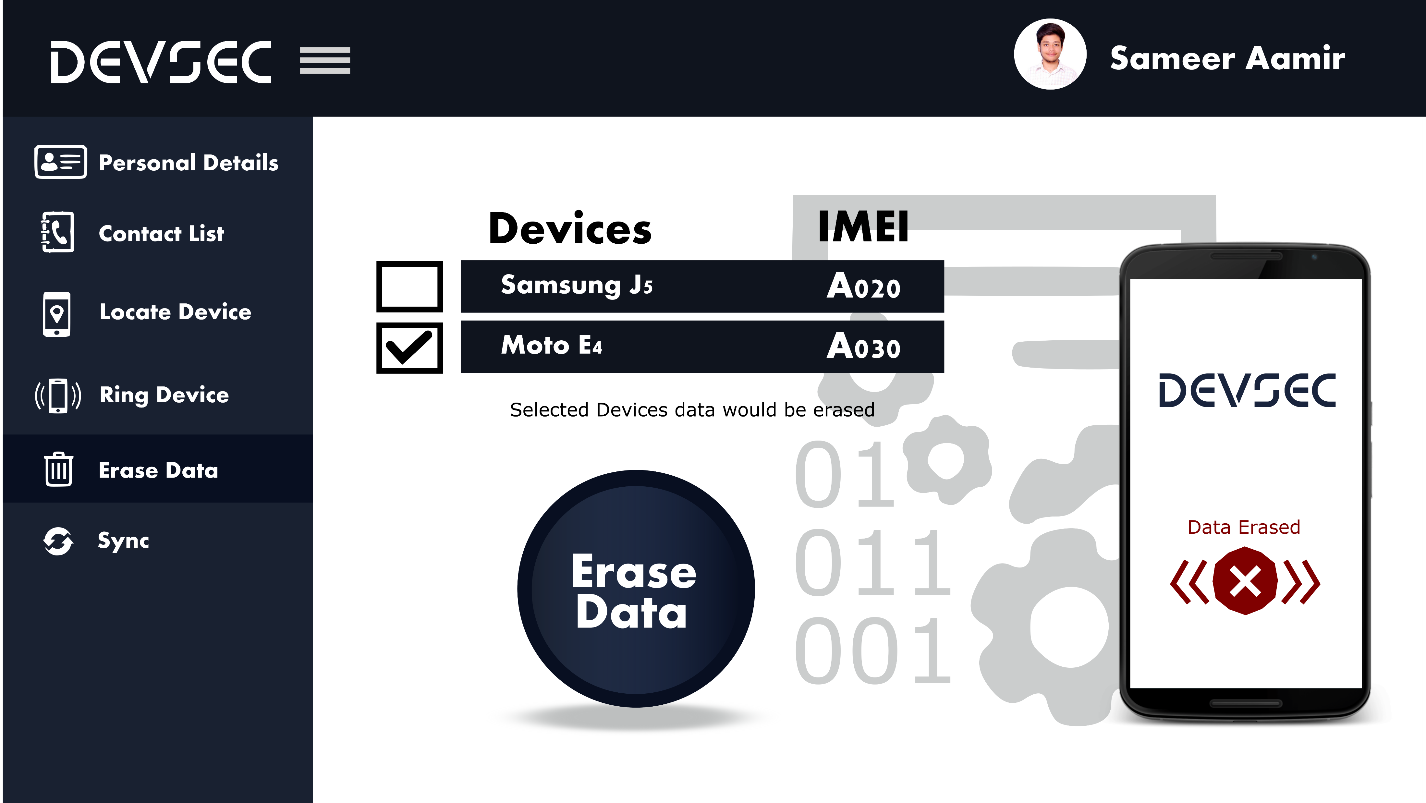

Slide 13
